Slide 1

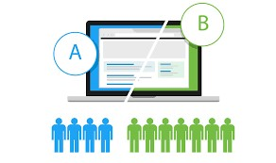
A / B TESTING ANALYSIS
Presented by:
Room no. : 303
CH .SRINU(TA)
CH .PREM KUMAR
Y.RAM SAI
M.RAGHAVENDRA
V.KRISHNA PRASAD
G.BHANU RAJESH

Slide 2
A/B TESTING
What is A/B Testing ?
A method of comparing two versions of a web page or app to determine which one performs better.
Why A/B test ?
To increase conversion rates, click-through rates, and other metrics through datadriven experimentation.
Best practices
Define your goals, choose your metrics, test one variable at a time, test large enough sample sizes

Slide 3
LIBRARIES :
NUMPY : To perform a wide variety of mathematical operations on arrays.
PANDAS : For data analysis & associated manipulation of tabular data in dataframes.
MATPLOTLIB : For creating static, animated and interactive visualizations.
SKLEARN : To interoperate with the python numerical and scientific libraries.

Slide 4
Algorithm :
Logistic Regression :It is a statistical method used for binary classification,where the goal is to predict a binary outcome based on one or more predictor variables.This method is widely used in machine learning and statistics tasks.
Logistic Regression Implementation :
Data pre-processing step
Hypothesis Testing
Predicting the test result
Test accuracy of the result ( creation of confusion matrix )
Visualizing the test set result

Slide 5
INPUTS:
Control-group
Test-group
Above are the two web pages names used for comparison .By comparing those web pages conversion rate we can decide which web page is effective and mostly used

Slide 6
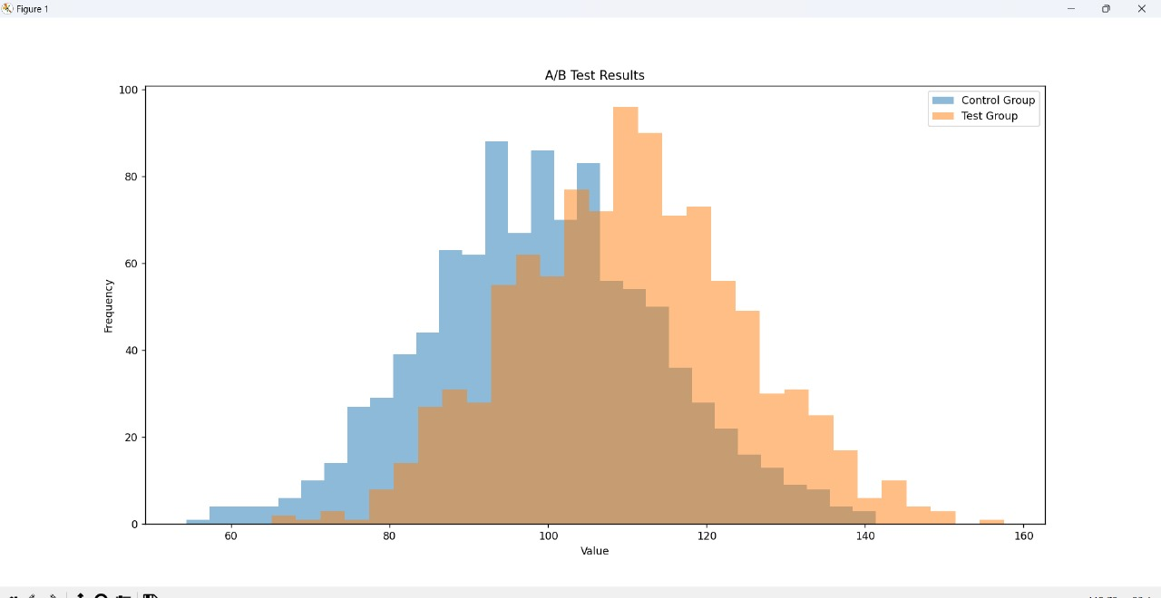
OUTPUT:

Slide 7
Benefits:
Optimizing User Experience
Reducing Risk
Testing Hypothesis
Competitive Advantage
Cost-Effective Marketing
Long Term Strategy

Slide 8
FUTURE ENHANCEMENTS:
MULTI-VARIANT TESTING : Move beyond simple a/b testing to multi variant tests to multiple changes simultaneously.
USER FEEDBACK INTEGRATION :Combine A/B test data with user feedback and qualitative research to gain a great view of user satisfaction.

Slide 9
CONCLUSION :
A/B testing, combined with machine learning, is a powerful approach for optimizing digital experiences. By leveraging data-driven insights, businesses can make informed decisions that lead to improved user engagement and conversion rates.

Slide 10


